Slide 1

DATABASE SYSTEMS ENGINEERING AND DISTRIBUTED BACKEND DEVELOPMENT (25CS1302E)
Learning Platform with AI Doubt Solver
Koushik S (2520090113) | A. Sai Charan Teja (2520080044) | Ch. Ganesh (2520090112)
Section 10 • Team 5 • Trimester 4 • 2026–27
Guide: Divya Priya Degala • K L (Deemed to be) University, Dept. of CSIT

Slide 2
Problem Statement & Objectives
Why a course-aware doubt solver?
Problem
Objectives
Students get blocked on technical concepts with no timely clarification
Generic answers are often unrelated to the syllabus
Without persistent storage, the history of doubts and responses is lost
Content, enrollment and instructor communication live in separate silos
Responsive platform for students and instructors
Course-aware doubt submission with module context
PostgreSQL for relational data, MongoDB for flexible assets
pgvector for semantic retrieval of course content
Advanced SQL: trigger, stored procedure, view
JWT + bcrypt security with role-based access
Layered routers → services → repositories backend

Slide 3
Scope & Target Users
Student
Instructor
Administrator
Register, browse the catalog, enroll, view modules, ask doubts, review history
Review doubts across assigned courses and inspect course-level analytics
Supported by the role model and security layer for future expansion
In scope
Course catalog, modules and enrollment with duplicate protection
pgvector retrieval, answer generation with stored source citations
Doubt history, instructor inbox, analytics view, deployment configuration

Slide 4
Technology Stack
React 19 + Vite
FastAPI + Uvicorn
PostgreSQL 16
SPA with React Router protected routes; Axios with JWT interceptor
Async REST API: routers, services, repositories, Pydantic
Users, courses, enrollments, doubts, responses; SQLAlchemy async
pgvector
MongoDB 6+
Deploy options
VECTOR(1536) embeddings; cosine top-3 search
course_assets and doubt_attachments via Motor
Compose full stack; Vercel frontend; Render for mock API
Testing: pytest, pytest-asyncio, pytest-cov, httpx • Security: bcrypt, JWT (python-jose)

Slide 5
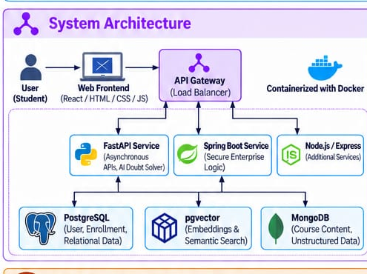
System Architecture
Implemented
React frontend → FastAPI service → PostgreSQL + pgvector and MongoDB, containerized with Docker
Illustrative (poster)
Spring Boot and extra Node/Express services show the intended distributed direction; the Express API is a demo fallback only

Slide 6
AI Doubt-Solving (RAG) Flow
Retrieval-oriented, with embedding and answer functions isolated for future LLM swap
1
2
3
4
Student picks course/module and submits a question
POST /doubts stores the doubt row
Question → deterministic 1536-d embedding
pgvector cosine search returns top 3 chunks
5
6
7
8
Answer from knowledge base or retrieved sentences
Response + source rows inserted
Trigger marks doubt as answered; commit
API returns answer, confidence, citations
Doubt, response and source rows commit as one transaction – no half-written answers.

Slide 7
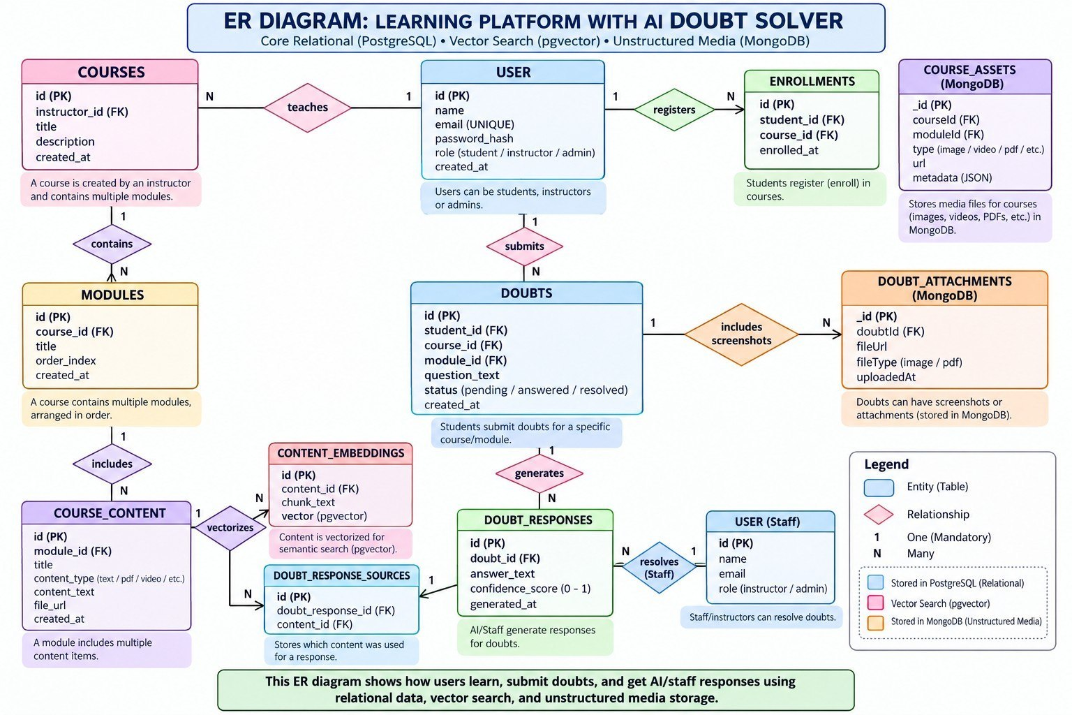
ER Diagram & Database Design
Highlights
Normalized PostgreSQL entities with FKs and UNIQUE constraints
Embeddings in a dedicated table
Responses and sources stored separately for provenance
MongoDB collections linked by logical IDs

Slide 8
Advanced SQL Objects
Trigger
Stored procedure
View
trg_mark_doubt_answered sets the parent doubt to answered after a response insert
enroll_student(student, course) inserts only if the pair is new – idempotent
course_doubt_analytics: total, pending, answered, escalated per course
Normalization
Transactions
Each fact stored once; junction table for sources; suited to 3NF/BCNF reasoning
Doubt + response + sources commit together; indexes speed common joins

Slide 9
Implementation & API
Method | Endpoint | Purpose
POST | /auth/register, /auth/login | Create user / get JWT
GET | /courses, /courses/{id} | Catalog and course tree
GET | /courses/{id}/analytics | Instructor/admin analytics
GET/POST | /enrollments | List / enroll
GET | /doubts?studentId=|instructorId= | History / inbox
POST | /doubts | Submit doubt, run RAG
GET | /health | Health check
Backend design
app/main.py → routers → services → repositories → PostgreSQL/MongoDB
Registration hashes passwords with bcrypt and returns a JWT
Login token carries user id and role
require_role() guards instructor/admin analytics
Frontend Axios interceptor adds Bearer token

Slide 10
Key Features
Student
Instructor & analytics
Registration / login with roles
Dashboard: enrolled courses, doubt counts, recent inquiries
Searchable course catalog and course detail with modules
Idempotent enrollment
AI Doubt Solver with confidence and source cards
My Doubts ledger with answered / pending / escalated filters
Role-protected Doubt Inbox across the instructor’s courses
Counts for total, answered, pending and escalated
course_doubt_analytics endpoint restricted to instructor/admin
Academic “catalog and ledger” interface instead of a chatbot look

Slide 11
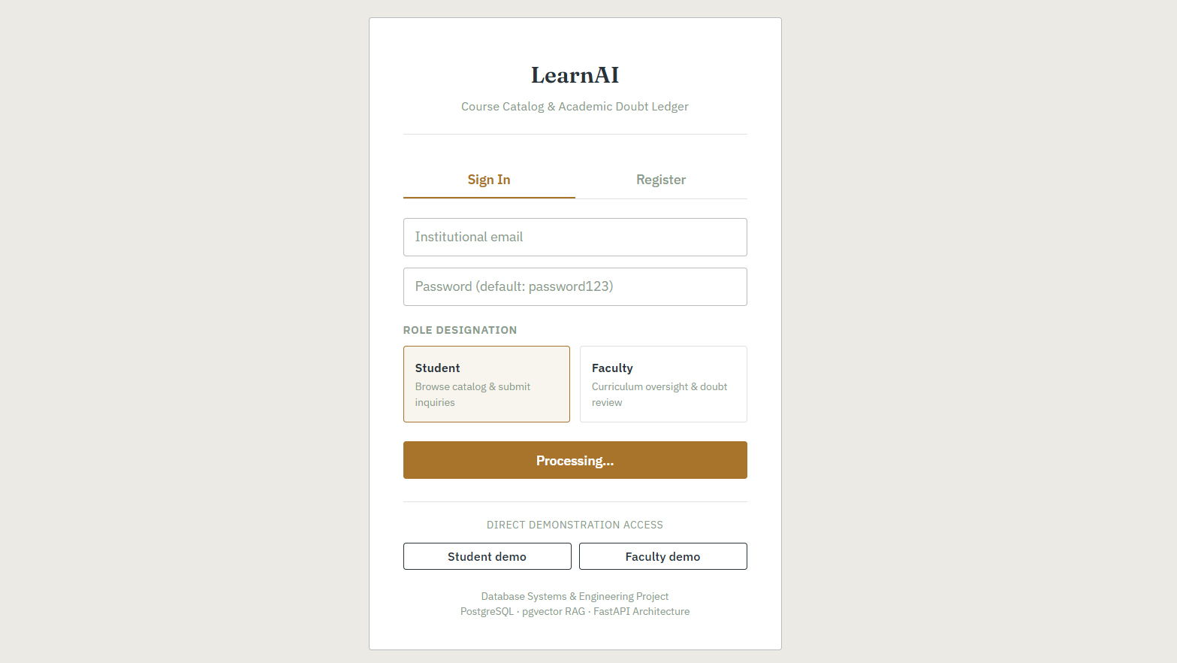
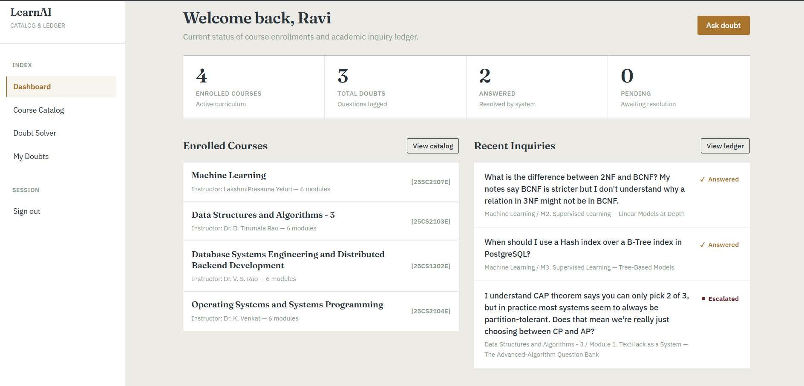

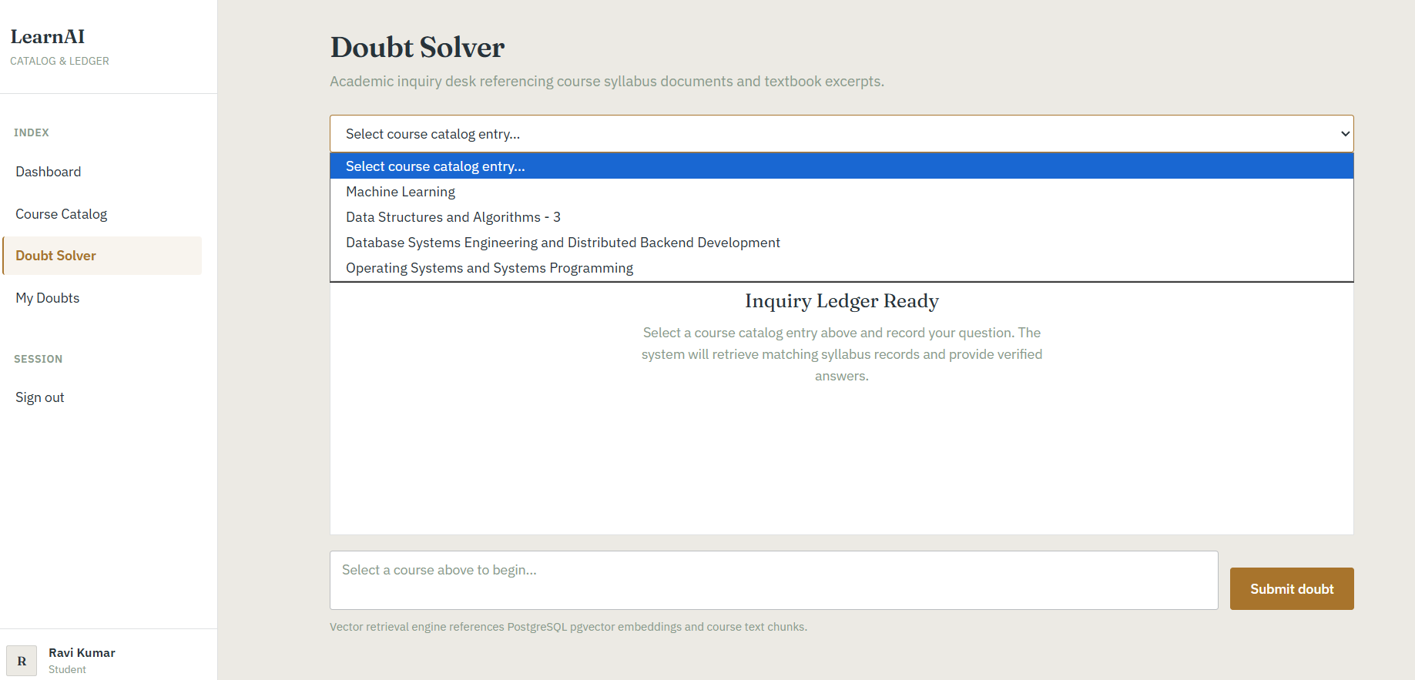
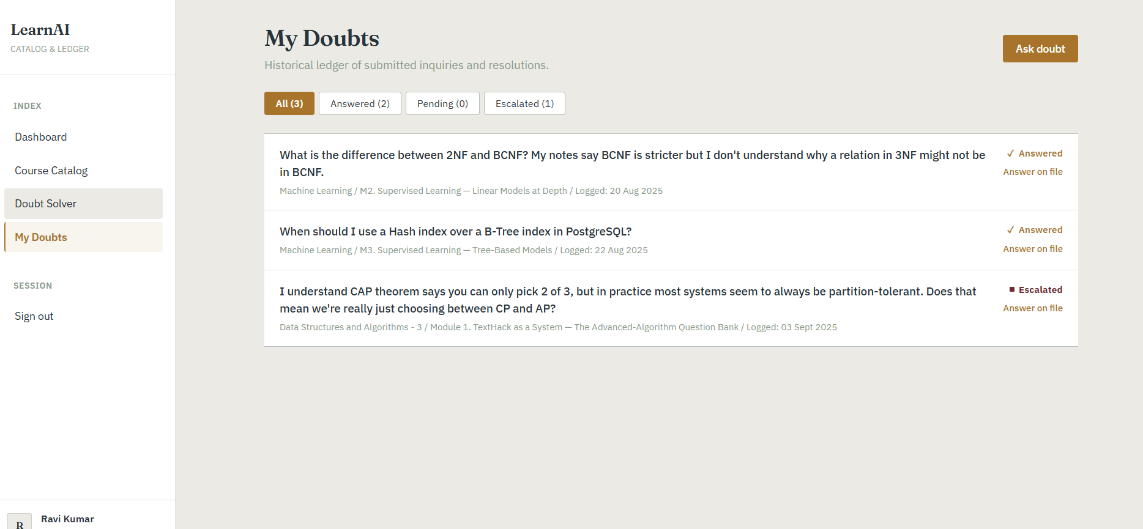
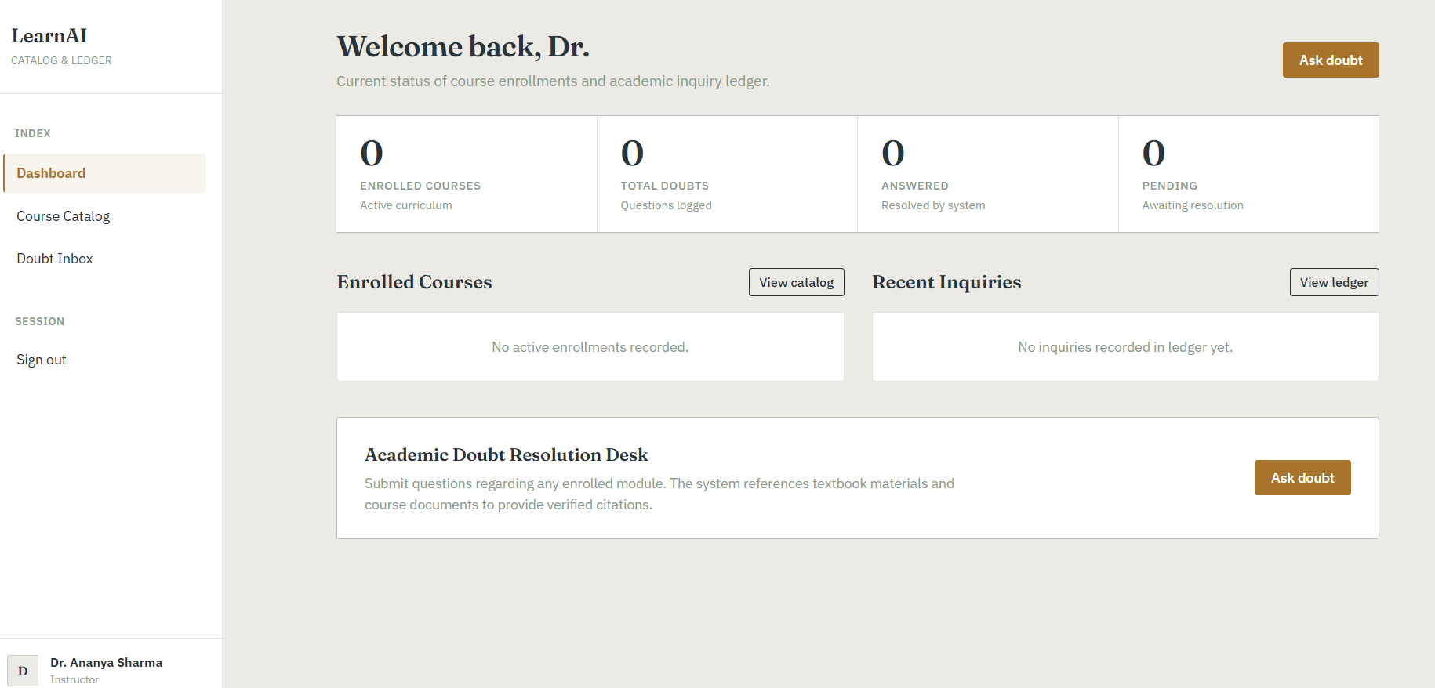
Application Screenshots
LearnAI – running application
Login
Student Dashboard
Course Catalog
Doubt Solver
My Doubts
Instructor Dashboard

Slide 12
Testing
17
5
Tooling
pytest + pytest-asyncio
httpx async client
Transaction-based DB fixtures
Swagger UI (/docs), ReDoc (/redoc)
Postman listed in poster
Load/security testing is future work
pytest test functions
areas covered: auth, courses, authorization, enrollment, doubts
What is verified
Register, duplicate email (409), wrong login (401)
Missing course/doubt (404); analytics without auth (401)
End-to-end doubt: answer, confidence, source shape
Trigger sets persisted status to answered

Slide 13
Deployment
Vercel (frontend)
Docker Compose
Render (fallback)
Vite build with SPA route rewrites
dbse-dbd.vercel.app/dashboard
pgvector/pgvector:pg16
Backend + frontend services
Reproducible polyglot demo
Legacy Express mock API
Not the real FastAPI backend
Configuration
DATABASE_URL, MONGO_URL, MONGO_DB_NAME, JWT_SECRET and token expiry via environment variables; .env.example documents them without secrets.

Slide 14
Challenges & Limitations
Challenges → Solutions
Current limitations
Mock Express → FastAPI migration: layered architecture kept the frontend contract
Atomic multi-step doubt creation: single transaction
Retrieval without an API key: replaceable deterministic embedding
PostgreSQL + MongoDB async: lazy Motor init, closed on shutdown
Embeddings are deterministic, not neural semantic
Answers are knowledge-base / template based, not a live LLM
No MongoDB asset/attachment CRUD endpoints yet
No Spring Boot service in the source
No production load, security or observability testing

Slide 15
Future Enhancements
AI
Distributed backend
Academic & cloud
Real embeddings (sentence-transformers, OpenAI, Gemini)
Grounded LLM answers
Confidence calibration, “insufficient context”
Follow-ups, multimodal attachments
Split auth, courses, doubts into services
API gateway, service discovery
Queues for embedding ingestion
Caching, logs, metrics, tracing
Instructor response and escalation workflow
Weak-topic analytics, recommendations
Notifications
Managed cloud DBs, CI/CD

Slide 16
Conclusion
React interface with protected navigation and a FastAPI layered backend
PostgreSQL trigger, stored procedure and analytics view; pgvector retrieval with source citations
MongoDB schemas, JWT/bcrypt security, 17 automated tests
Clear separation between the implemented system and future AI / distributed enhancements
Thank you
Team 5 • Guide: Divya Priya Degala

